Slide 1
University of Lodz
Faculty of Management
Basics of Entrepreneurship and Management 14h
Assoc. Prof. Marek Matejun, D.Sc.
Department of Entrepreneurship and Industrial Policy
marek.matejun@uni.lodz.pl

Slide 2
Basics of Entrepreneurship and Management
Scope of the course
Entrepreneurship as the basis for business development and performance
Key entrepreneurial characteristics and attitudes
Small business and innovativeness
Management process and decision making
Selected concepts and methods of management

Slide 3
Basics of Entrepreneurship and Management
Organizational issues
Visit www.matejun.pl to get presentation(s)
(Dla studentów – „For students”), pass: blue
Visit www.matejun.com for more info ☺
Form of assessment:
knowledge test at the last meeting – participation is obligatory!
entrepreneurial & managerial trainings
Office hours:
MS Teams; Tuesdays, 6.30 pm – 8.00 pm; link on my website
contact via e-mail: marek.matejun@uni.lodz.pl

Slide 4
Basics of Entrepreneurship and Management
Organizational issues
Course schedule:
Mondays 8.30 – 10.00 am (2h)
2024-10-14
2024-10-28
2024-11-18
2024-12-02
2024-12-16
2025-01-13
2025-01-27 (test!)
meetings without breaks!
2h x 7 = 14ths in total
lectures / workshops / activities

Slide 5
The concept of entrepreneurship
A complex, ambiguous concept, difficult to define precisely
In general terms, we usually associate „entrepreneurship” with certain characteristics or attitudes:
innovativeness, creativity, seeking for change and responding proactively to it,
exploration and exploitation of opportunities,
readiness to take (calculated) risks,
acting in order to gain profit,
running own company.
The necessity of entrepreneurship: in the family, in the local environment, in the professional life - in one's own company and in hired work, in the market economy - as a foundation for creating free market and increasing competitiveness.

Slide 6
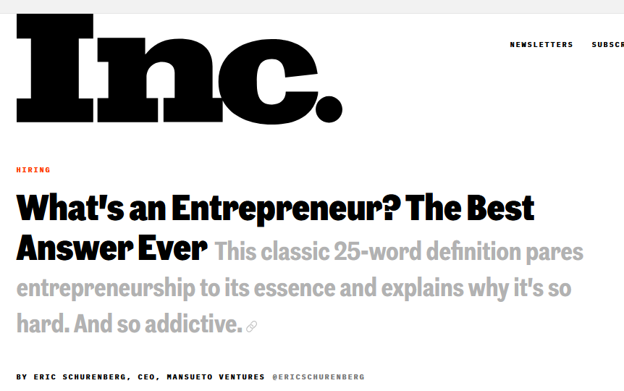
The „best” definition of entrepreneurship
From Jessica Jackley blog: http://www.jessicajackley.com/blog/2016/1/8/the-pursuit
My favorite definition of entrepreneurship comes from Harvard Business School professor Howard Stevenson: "Entrepreneurship is the pursuit of opportunity without regard to resources currently controlled”. In other words, entrepreneurship is the ability to pursue opportunity without money, or permission, or pedigree, or most other means that might make the pursuit easier. Stevenson emphasizes the pursuit without regard to possessions. As I see it, his definition hints at this truth: the heart of entrepreneurship is never about what we have. It’s about what we do. Great entrepreneurs embody Stevenson's definition: they choose, day after day, to move forward in pursuit of an opportunity, regardless of what they control or don't control. Regardless of what they lack or have lost or must fight against. They succeed not because of what they possess but because of what they are determined to achieve’

Slide 7
1. Definitions that underline the economic functions of entrepreneurship
3. Entrepreneurship as a specific type of managerial behavior
2. Definitions that underline the personal characteristics of entrepreneurial individuals

Slide 8
Definitions that underline the economic functions of entrepreneurship
[Hisrich, Peters]
„ Entrepreneurship is the process of creating something new with value by devoting the necessary time and effort, assuming the accompanying financial, psychic and social risks and receiving the resulting rewards of monetary, personal satisfaction and independence”
[Vesper, Ronstadt]
initiating the taking of some action,
organizing economic mechanisms that direct resources to practical use,
accepting uncertainty and risk in one's activities.

Slide 9
Definitions that underline the personal characteristics of entrepreneurial individuals
Commitment, engagement, determination and persistence
overcoming barriers, obstacles, difficulties,
compensating for disadvantages and limitations,
Strong need for achievements
the desire to be outstanding, to succeed in a competitive environment,
concentration on tasks and responsibilities, striving to do one's best,
Initiative and responsibility
actively seeking and taking initiative,
seeking out situations involving personal responsibility for results,
Seeking for feedback
need for information about the results of one's actions,
as a result, improvement of actions, part of the learning process.
Internal location of control
success or failure dependent on the entrepreneur,
limited role of luck, fate or other external forces.
Taking calculated risks
the opposite to "risk-taking," "gambling”.„
avoiding unnecessary risks, making well thought out decisions.

Slide 10
Definitions that underline the personal characteristics of entrepreneurial individuals
Tolerance of uncertainty
acceptance of constant change, stress, lack of order
ability and willingness to act under such conditions
Honesty and trustworthiness
attributes of a trustworthy person,
fundamental qualities in running a business.
Ability to accept failure
failures and defeats as an integral part of entrepreneurial behavior,
failures more instructive than successes.
Creativity and innovativeness
a change-seeking attitude,
creating new ideas, using ideas in a different way,
Self-confidence and optimism
necessary in difficult moments,
positive thinking, focus on success.
The need for autonomy, independence
the desire to operate outside of bureaucratic systems,
the desire to make decisions independently.

Slide 11
Entrepreneurship as a specific type of managerial behavior
Strategic thinking and orientation
formulating a strategy based on vision and opportunities,
not being limited by available resources.
Engaging in opportunities
taking quick action,
hunting for opportunities,
acting in a revolutionary style.
Team building abilities
ability to select people,
maintaining high motivation among co-workers.
Hiring specialists
Knowledge of how to exploit the capabilities of specialists.
Direct contact with the environment
Developing social communication networks and structures.

