Slide 1
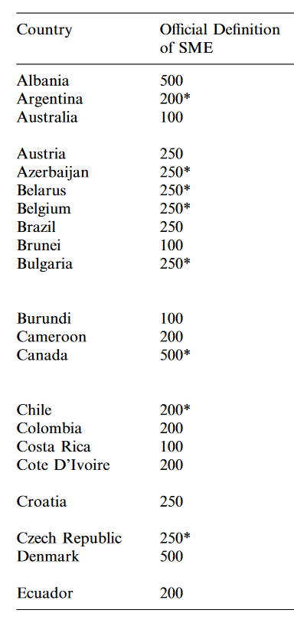
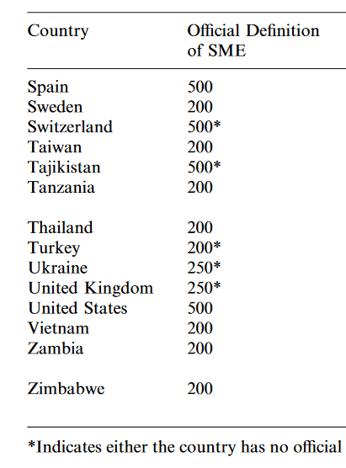
Small business as a spirit of entrepreneurship
Small business (SMEs) is defined on the basis of quantitative and/or qualitative criteria in many countries:
Source: Ayyagari, M., Beck, T., Demirgüç-Kunt, A. (2007). Small and medium enterprises across the globe. Small Business Economics, 29(4), 415-434

Slide 2
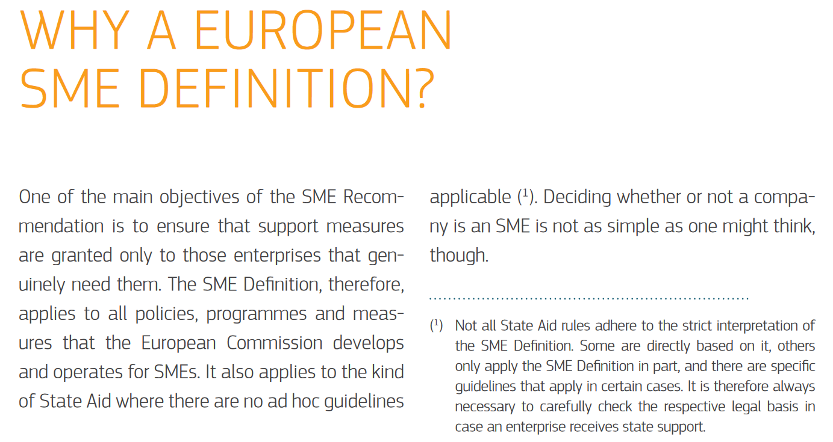
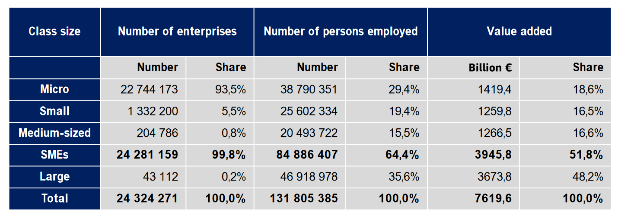
Small business in the EU

Slide 3
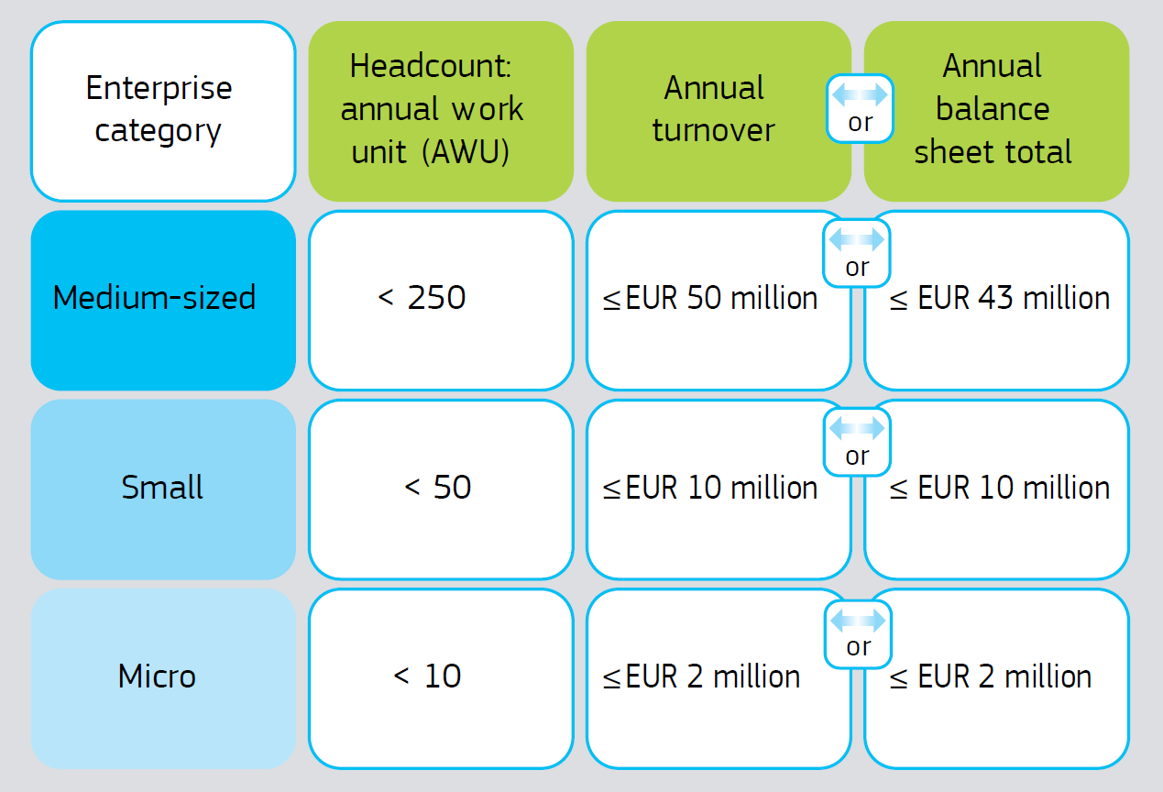
Definition of small business
In the European Union: Uniform, formal definition of micro, small and medium-sized enterprises (SMEs)
Staff headcount: number of employed persons
Annual turnover: income that an enterprise received during the year
Annual balance sheet total: value of a company’s main assets
AND
Additional criterion: Capital/ownership independence from other entities
Defines an autonomous enterprise, a partner enterprise or a linked enterprise. Where there are excessive equity/ownership relationships, these should be taken into account when determining overall staffing levels and financial values.

Slide 4
Criterion: Staff headcount
The staff headcount is the main criterion for determining whether an enterprise can be considered an SME and, if so, in which category the SME falls. If an enterprise does not meet it, it cannot be considered an SME.
The staff headcount criterion covers full-time, part-time, temporary and seasonal staff and includes the following groups:
employees;
persons working for the enterprise who have been seconded to it and are considered to be employees under national law (this can also include temporary or so-called interim employees);
owner-managers;
partners engaged in a regular activity in the enterprise and gaining financial advantages from the enterprise.
Not included in staff headcount:
apprentices or students who are engaged in vocational training and have apprenticeship or vocational training contracts;
employees on maternity or parental leave.
Measuring staff headcount:
Headcount is expressed in annual work units (AWUs). Anyone who worked full time within an enterprise, or on its behalf, during the entire reference year, counts as one unit. Part-time staff, seasonal workers and those who did not work the full year are treated as fractions of one unit.

Slide 5
Financial criteria
Annual turnover
Annual turnover is determined by calculating the income that an enterprise received during the year from the sale of products and provision of services falling within the company’s ordinary activities, after deducting any rebates.
Turnover does not include value added tax (VAT) or other indirect taxes
Annual balance sheet total
The annual balance sheet total refers to the value of a company’s main assets
Determining company size over time
UE definition provides stability and certainty to companies that are close to the levels of criteria and risk exceeding them temporarily during an exceptional year and/or in volatile markets.
Thus, if an enterprise exceeds the headcount or financial criteria during the course of the reference year, this will not affect its situation and it will retain the SME status
However, it will lose SME status if it goes above the criteria levels for two consecutive years.
Conversely, an enterprise may get SME status again if it was previously a large enterprise but then fell below the criteria levels for two consecutive years.

Slide 6
Capital/ownership independence from other companies
The problem:
A very attractive non-repayable grant for micro-enterprises is available: €5 million of funding for innovation activities
BIG company (1000 employees) wants to get this grant but is not a micro-enterprise ☹
What to do?
BIG company creates fully controlled subsidiary (daughter company) which employs 5 persons – this subsidiary is fully (100%) owned by a large company:
Fully owned micro-subsidiary
BIG company

Slide 7
Capital/ownership independence from other companies
To limit such activities, the EU definition introduces three categories of companies: (1) an autonomous enterprise (2) a partner enterprise (3) a linked enterprise.
An autonomous enterprise:
is totally independent, i.e. it has no ownership participation in other enterprises; and no enterprise has an ownership participation in it OR
has a holding of less than 25 % of the capital or voting rights (whichever is higher) in one or more other enterprises; and/or any external company have a stake of no more than 25 % of the capital or voting rights (whichever is higher) in the enterprise
For determining the size status of an autonomous, only the level of employment and financial volumes from an independent company are taken into account, not including capital partners
An enterprise may still be considered autonomous even if the limit of 25% ownership engagement is exceeded (max 50%) by any of the following types of investors:
venture capital companies and business angels with financial involvement below EUR 1 250 000.
universities and non-profit-making research centres;
regional development funds;
autonomous local authorities with an annual budget of less than EUR 10 million and fewer than 5 000 inhabitants.

Slide 8
Capital/ownership independence from other companies
A partner enterprise:
owns between 25% and 50% of the capital or voting rights in another enterprise, and/or another enterprise owns between 25% and 50% of the capital or voting rights of this enterprise.
In order to determine the size status of partner enterprise, the percentage of its employed persons and financial data of its capital partners must be added to its employment level and financial data.
Example:
BIG company (1000 persons) controls „ABC company” in 40%. ABC employs 60 persons. Is „ABC company” a medium-size company?
60 + 40%*1000 = 460 persons → ABC is also big company

Slide 9
Capital/ownership independence from other companies
A linked enterprise :
Two or more enterprises are linked when they have any of the following relationships:
one enterprise holds a majority of the shareholders’ or members’ voting rights in another;
one enterprise is entitled to appoint or remove a majority of the administrative, management or supervisory body of another;
a contract between the enterprises, or a provision in the memorandum or articles of association of one of the enterprises, enables one to exercise a dominant influence over the other;
one enterprise is able, by agreement, to exercise sole control over a majority of shareholders’ or members’ voting rights in another.
Summary: A linked enterprise is an enterprise with capital/ownership relation with other company in more than 50%
A typical example of a linked enterprise is the wholly owned subsidiary.
In order to determine the size status of a linked company, 100% of the number of its employees and financial data should be added to the level of its employment and financial data related to its capital partners

Slide 10
Capital/ownership independence from other companies
The problem:
A very attractive non-repayable grant for micro-enterprises is available: €5 million of funding for innovation activities
BIG company (1000 employees) wants to get this grant but is not a micro-enterprise ☹
What to do?
BIG company creates fully controlled subsidiary (daughter company) which employs 5 persons – this subsidiary is fully (100%) owned by a large company:
Fully owned micro-subsidiary
5
BIG company
Size of fully owned micro-subsidiary:
5 + 100%*1000 = 1005
IT IS NOT A MICRO ENTEPRISE!!
1000

Slide 11
Managerial training:
REFINA company case study
Question: What is a size of REFINA company according to EU definition of SMEs? Please provide detailed calculations for all criteria included in this definition.

