Slide 1
Innovation – concept and types
General definition:
It is a practice or object that is perceived as new by an individual, company or other unit of adoption.
It is a use of new knowledge to offer a new product or new service that market wants. Thus
Innovation = Invention + Novelty + Commercialization

Slide 2
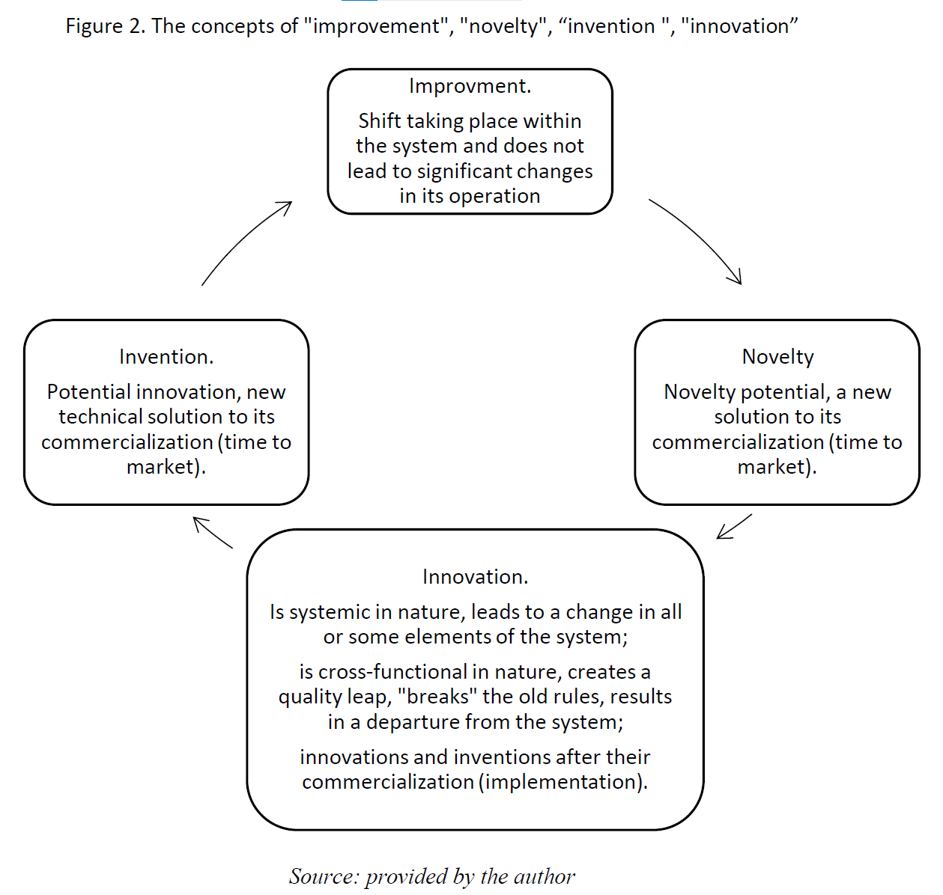
Innovation – concept and types
Approach by T. Kogabayev & A. Maziliauskas (2017):
Kogabayev, T., & Maziliauskas, A. (2017). The definition and classification of innovation. Holistica, 8(1), 59-72.

Slide 3
Many definitions of innovation
E.g. research by: A. Baregheh, J. Rowley, & S. Sambrook (2009):
Baregheh, A., Rowley, J. and Sambrook, S. (2009). Towards a multidisciplinary definition of innovation. Management Decision, 47(8), 1323-1339.
They analyzed 60 definitions of innovations from literature
They identified 6 attributes which form the basis for an integrative definition of innovation:
Nature of innovation refers to the form of innovation as in something new or improved.
Type of innovation refers to the kind of innovation as in the type of output or the result of innovation, e.g. product or service.
Stages of innovation refers to all the steps taken during an innovation process which usually start from idea generation and end with commercialization.
Social context refers to any social entity, system or group of people involved in the innovation process or environmental factors affecting it.
Means of innovation refers to the necessary resources (e.g. technical, creative, financial) that need to be in place for innovation.
Aim of innovation is the overall result that the organizations want to achieve through innovation.

Slide 4
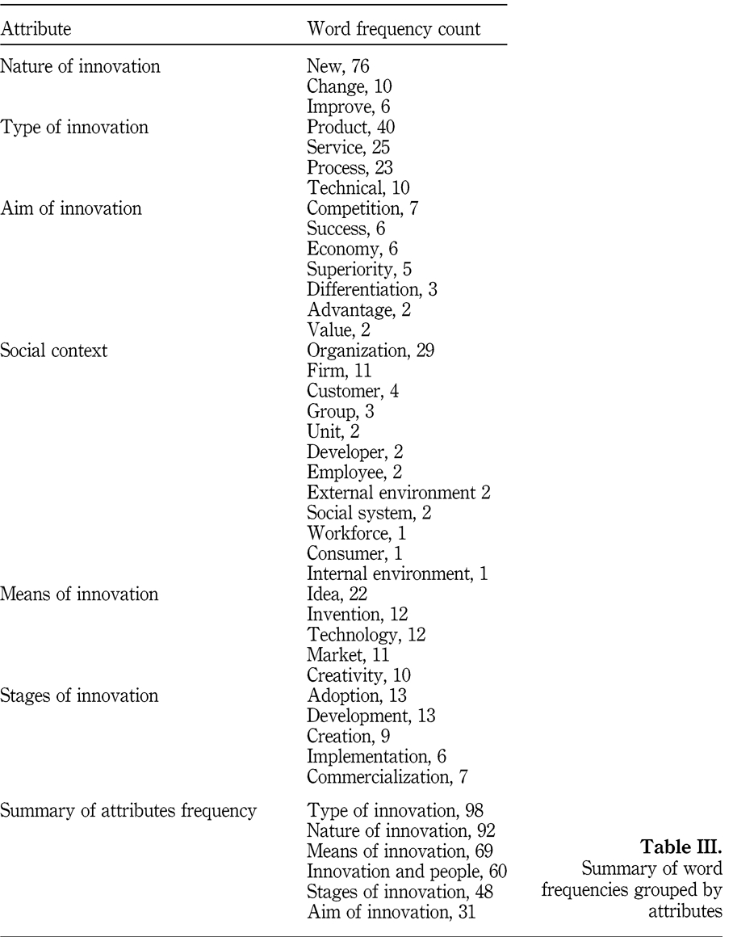
Innovation – concept and types
Their results:
On that basis they propose own definition:
Innovation is the multi‐stage process whereby organizations transform ideas into new/improved products, service or processes, in order to advance, compete and differentiate themselves successfully in their marketplace.

Slide 5
Innovation in Oslo Manual
One of the most powerful publications on innovation is OSLO MANUAL
Last edition: 4th from 2018
258 pages on innovations!
Concentrates on definition and measuring innovations in business practice
From preface:
„The Oslo Manual provides guidelines for collecting and interpreting data on innovation. It seeks to facilitate international comparability, and provides a platform for research and experimentation on innovation measurement. Its guidelines are principally intended to support national statistical offices and other producers of innovation data in designing, collecting, and publishing measures of innovation to meet a range of research and policy needs. In addition, the guidelines are also designed to be of direct value to users of information on innovation”
https://www.oecd.org/science/oslo-manual-2018-9789264304604-en.htm

Slide 6
Innovation in Oslo Manual
According to Oslo Manual:
An innovation is a new or improved product or process (or combination thereof) that differs significantly from the unit’s previous products or processes and that has been made available to potential users (product) or brought into use by the unit (process).
Innovation activities include all developmental, financial and commercial activities undertaken by a firm that are intended to result in an innovation for the firm.
innovation = outcome; innovation activities = process
They distinguish 2 main types of innovation:
A product innovation is a new or improved good or service that differs significantly from the firm’s previous goods or services and that has been introduced on the market.
A process innovation is a new or improved business process for one or more business functions that differs significantly from the firm’s previous business processes and that has been brought into use by the firm.

Slide 7
Innovation in Oslo Manual
A product innovation:
Goods include tangible objects over which ownership rights can be established and whose ownership can be transferred through market transactions.
Services are intangible activities that are produced and consumed simultaneously and that change the conditions (e.g. physical, psychological, etc.) of users. The engagement of users through their time, availability, attention, transmission of information, or effort is often a necessary condition that leads to the co-production of services by users and the firm. The attributes or experience of a service can therefore depend on the input of users.

Slide 8
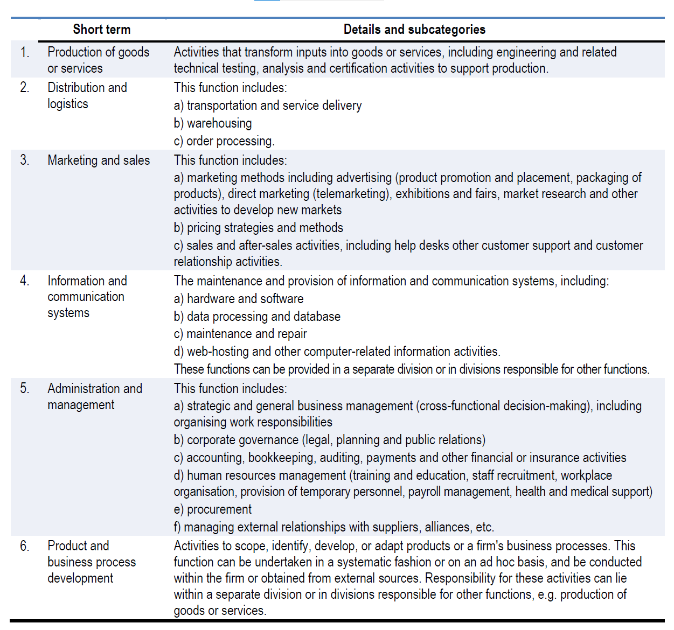
Innovation in Oslo Manual
A process innovation:

Slide 9
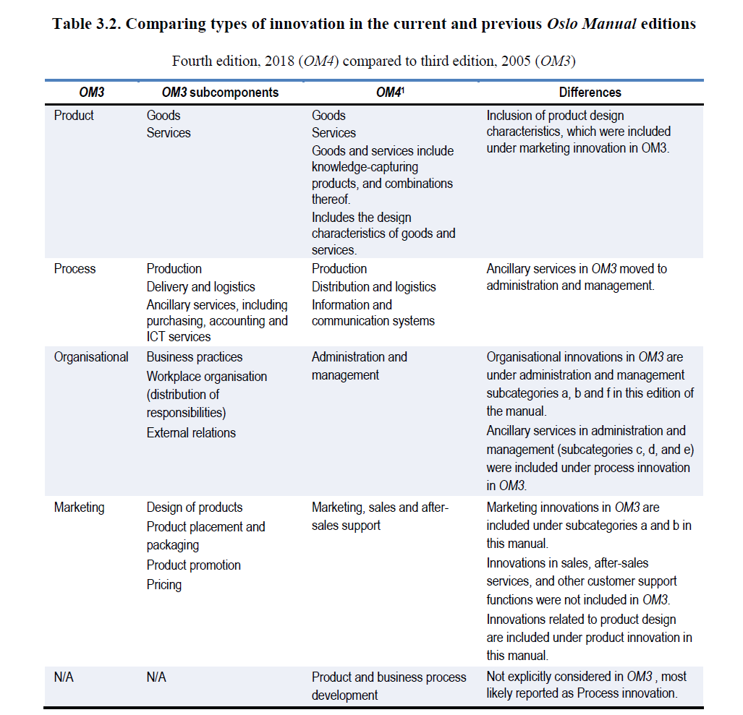
Oslo Manual: 2018 vs 2005
2005:
product
process
organizational
marketing
2018:
product
process

Slide 10
Innovative company in Oslo Manual
According to Oslo Manual:
The innovation status of a firm is defined on the basis of its engagement in innovation activities and its introduction of one or more innovations over the observation period, which can vary between one and three years.
During this observation period, any given innovation activity of the firm can:
Result in an innovation. The innovation activity can consequently cease during the observation period after implementation or it could still be ongoing if it is undertaken for other innovation projects.
Be ongoing without an innovation. Work can still be in progress and proceeding according to plan, or delayed due to various reasons, such as technical difficulties or a shortage of expertise or finance.
Be aborted, discontinued, or put on hold, for instance when activities to develop an innovation are stopped before implementation.

Slide 11
Innovative company in Oslo Manual
These three outcomes apply to the wide array of innovation activities within a firm:
These combinations result in three core definitions of enterprises:
An innovative firm reports one or more innovations within the observation period. This applies equally to a firm that is individually or jointly responsible for an innovation.
A non-innovative firm reports no innovations within the observation period.
An innovation-active firm is engaged at some time during the observation period in one or more activities to develop or implement new or improved products or business processes for an intended use. Both innovative and non-innovative firms can be innovation-active during an observation period.

Slide 12
Entrepreneurial training
Team work
Based on the internet prepare short presentation describing real innovation. How this innovation should be classified according to Oslo Manual 2018 classification? Include pictures if possible!
Send presentation to my e-mail: marek.matejun@uni.lodz.pl (include names of team members!)

