Slide 1
Management is performed by managers
A manager is a person responsible for planning and directing the work of a group of individuals, monitoring their work, and taking corrective action when necessary.
A manager is someone who coordinates and directs the work of other people so that organizational goals can be accomplished
A manager is the organizational memeber authorized to tell others what to do and how to do it.
Manager differs from nonmanagerial employees that he is responsible for the work, which does not perform himself, but also by his/her subordinates.
There are various managers in modern organizations. They can be classified according to level and area of management

Slide 2
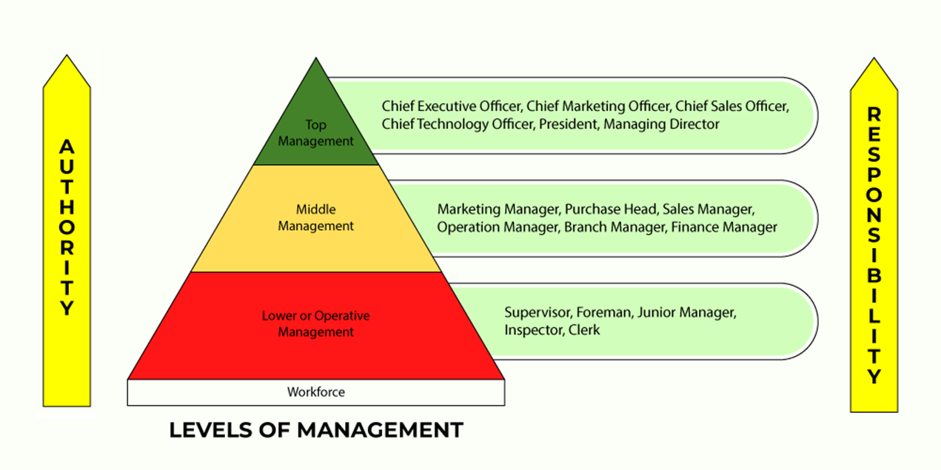
Managers according to level of management
https://www.geeksforgeeks.org/levels-of-management/
Administrative or Top Level of Management.
Executive or Middle Level of Management.
Supervisory or Lower Level of Management.

Slide 3
Managers according to level of management
The main functions of the top level management:
The top level management determines the objectives, policies and plans of the organization.
They mobilizes (assemble and bring together) available resources.
The top level management does mostly the work of thinking, planning and deciding. Therefore, they are also called as the Administrators and the Brain of the organization.
They spend more time in planning and organizing. They prepare long-term plans of the organization which are generally made for 5 to 20 years. The top level management has maximum authority and responsibility.
They are directly responsible to the shareholders, law/government and the general public.
The success or failure of the organization largely depends on their efficiency and decision making.

Slide 4
Managers according to level of management
The main functions of the middle level management:
Middle level management executes (implements) the policies and plans which are made by the top level management.
The middle level management has limited authority and responsibility.
They are intermediary between top and lower management. They are directly responsible to the Chief Executive Officer and Board of Directors.
They spend more time in co-ordinating and communicating.
It co-ordinate the activities of all the departments. They also have to communicate with the top level management and the lower level management.
They prepare short-term plans of their departments which are generally made for 1 to 5 years.
Middle level management also gives recommendations (advice) to the top level management.

Slide 5
Managers according to level of management
The main functions of the lower level management:
Lower level management directs and leads the employees. They develops morale and angagement of the workers.
It maintains a link between workers and the middle level management. The lower level management informs the workers about the decisions which are taken by the management.
They also inform the higher management about the performance, difficulties, feelings, demands, etc., of the workers.
They spend more time in directing, leading and controlling.
The lower level managers make daily, weekly and monthly plans.
They have limited authority but important responsibility of getting the work done by the workers.
They regularly report and are directly responsible to the middle level management.

Slide 6
Managers according to area of management
General managers - supervise the entire unit and are not associated with any specific area. They coordinate the activities of all the managers of specialized areas. They should have a basic knowledge of all areas of management.
Functional managers - have responsibility for only one type of activity, e.g.:
Marketing managers. Responsible fora acquiring customers and consumers for the organization's products and services; development of new products; promotion, distribution of products and services
Finance managers. Responsible for accounting; cash management; analysis of financial liquidity; investments; determining the profitability of business
Production managers. Responsible for production control, inventory management; quality control, design of production technologies
Human resources managers. Responsible for HR planning, recruitment and selection of employees; HR training and development; design of incentive systems; formulation of employee performance appraisal systems;
Public-relations managers. Responsible for public and media relations
Research and development managers. Coordinate the activities of scientists and engineers working on research and development projects for new products and services

Slide 7
Managerial roles
The concept of 10 Managerial Roles, According to Henry Mintzberg
10 managerial roles divided into 3 categories:
3 Interpersonal roles: This category covers behaviors, tasks and responsibilities related to interactions with employees and other stakeholders. Through these interactions, the manager can achieve organizational goals. The managerial roles included in this category are (1) figurehead, (2) leader and (3) liaison.
3 Informational roles: This category represents situations when a manager generates, receives or shares information and/or knowledge inside and/or outside of the organization. The managerial roles included in this category are (4) monitor, (5) disseminator and (6) spokesperson.
4 Decisional roles: This category describes a manager's responsibility to use the information they gain to form strategic and operational decisions. The managerial roles included in this category are (7) entrepreneur, (8) disturbance-handler, (9) resource-allocator and (10) negotiator.

Slide 8
Managerial roles
Interpersonal roles
(1) Figurehead: Managers often act as figures representing the organization, such as welcoming guests, participating in the opening of ceremonies, important moments for the organization. These activities are generally more ceremonial and symbolic than substantive. By acting in this role, the manager is a symbol of the organization.
(2) Leader: it is played when training, encouraging, guiding, motivating, or evaluating employees. A manager plays a leadership role formally or informally by giving subordinates information and instructions on how to work and achieve the right results.
(3) Liaison (connector): in this role managers create and maintain internal and external relationships. They serve as a connection between different people, groups or organizations to ensure work runs smoothly. As a liaison, they transfer knowledge or information to members across organization or communicate between stakeholders and employees to ensure projects remain on task. In some situations, they may bring members of your external network into the company to help achieve organizational goals more efficiently.

Slide 9
Managerial roles
Informational roles
(4) Monitor: In their work, managers actively seek out valuable information that allows them to perform activities and make decisions effectively. Such information comes both from within the organization (e.g., from employees, reports or statements) and from the environment (media, industry information or reports).
(5) Disseminator: managers as a disseminators convey information to the appropriate individuals or groups inside the organization. They can transmit this information in both verbal and written formats. Usually, this situation refers to valuable or otherwise important information that will benefit your organization or provides guidance on tasks your employees need to complete.
(6) Spokesperson: focuses on external communication and involves formally conveying information to stakeholders outside the organization. In this role, the manager is formally the carrier of information that he or she communicates to external audiences.

Slide 10
Managerial roles
Decisional roles
(7) Entrepreneur: this role is related to the creation and implementation of new, innovative ideas and solutions This role include creative solving problems as well as developing and implementing new ideas or strategies. These ideas and decisions often promote innovative solutions that move the organization forward.
(8) Disturbance handler: in their work, managers deal with solving problems and conflicts that arise in the organization. When organization or team face unexpected challenges, managers take the role of a disturbance handler to help manage the issue.
(9) Resource allocator: in this role managers are responsible for managing and distributing resources across the organization. They also distribute tasks, authority and responsibility.
(10) Negotiator: in this role, the manager negotiates with other groups or organizations in many situations necessary for the proper functioning of the company. An example of the implementation of this role would be negotiating external agreements (e.g., with business partners), as well as those occurring within the organization (e.g. negotiations with labor unions).

Slide 11
Managerial game: Roles of managers
Work in teams
Each team randomly picks roles according to the concept of H. Mintzberg (don't show/tell what role it is!!).
Then prepare in the team a scene presenting the role - you can play the role of the manager, employees, outsiders of the organization - depending on the needs of the managerial role (at the beginning introduce what characters play in the scene)
After the preparation, each group plays the scene in the middle of the room, and the other participants try to guess which managerial role it is about ☺

