Slide 1
Organizational issues
Visit www.matejun.pl to get presentations
(Dla studentów – „For students”), pass: human
4 meetings (3 ths, 3pm – 5.15 pm)
28 April, 05 May, 12 May, 19 May
Attendance is obligatory
Form of assessment:
Test (20 single-answer questions)
two options: (1) Select the correct answer, (2) Select the wrong answer, eg.:
(Q) Select the wrong answer: Component of transformational leadership is:
Intellectual stimulation
Individualized consideration
Shared leadership
Inspirational motivation
HRM trainings (additional points)

Slide 2
Team Work
Team is a small number of committed people who works together to accomplish a common goal in a certain time
Team work is the ability to work together toward a common vision. It is the fuel that allows common people to attain uncommon results. It is cooperation between members with diverse skills and background to achieve a common goal.
Key elements of a team:
Formal: intentionally created organization
Size: generally smaller in size
Common goal: work for one specific goal
Proper communication: undestrood, effective
Openness: everyone feels free to put views
Commitment: engagement of each team member
Trust: everyone shares and respect each other
Responsibility: individual and mutual
Time period: temporary nature

Slide 3
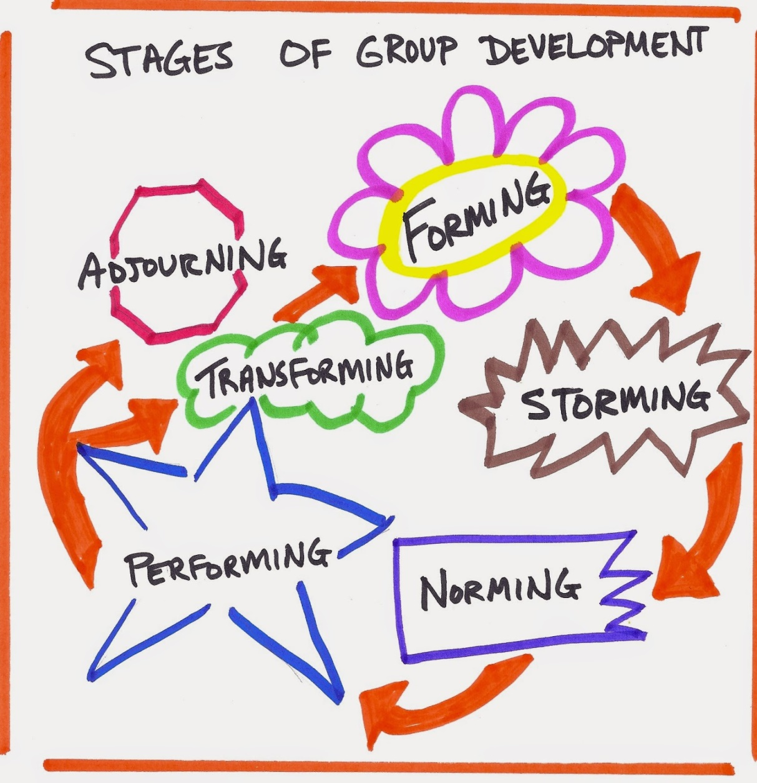
Team building process
Forming
Stage of initial orientation and interpersonal testing
Seeking and exchange some personal information; making new friends and alliances
Desire to be accepted by others
Gathering impressions about each other
Storming
Stage of conflict over the task and the way of performing
Conflict arises for power, leadership and decision making
Competition and strained relationships among team members (emotional and tensed)
Most critical stage for the team building

Slide 4
Team building process
Norming
Agreement on the mutual plan for the team
Agree with others to make the team functions and performance
Roles are defined
Rules, values, behaviours, methods and procedures are established
Performing
Members motivated and knowledgeable
Participation and understanding of team work importance
Strong engagement/commitment of each team member
Team member oriented towards common goal
Adjourning/Deforming
Task completed. Revision, analysis and evaluation of achievements
Feedbacks and acknowledgements
Reflections on strategies
Disassembled

Slide 5
Leadership in team work
Leader: Someone who can influence others to do and achieve something; who has authority and (usually) managerial skills
Leadership: The process of leading a group and influencing that group to achieve its goals; acts of guiding, influencing, directing, inspiring, and/or motivating the actions of others to achieve organizational goals.
Types of leadership:
Transactional leadership
Is initiated solely by the leader; is based upon the exchange of valued goods between the leader and followers;
Is based usually on tangible (money, resources) or intangible (time, recognition, praise, etc.) goods; is not based on an deeper relationship; therefore both parties go their separate ways
Is based on model of punishment, respect for authority
Administrative; maintaining status quo; prefers structures, control
Aimed at tactical goals

Slide 6
Leadership in team work
2. Transformational leadership
stimulate and inspire (transform) followers to achieve extraordinary outcomes; is based on mutual relationship between leader and followers
elevates both leader and followers to higher levels of motivation and engagement
provides the opportunity over time followers have the potential to be changed (transformed) into leaders themselves
Four components of transformational leadership:
Intellectual stimulation
Transformational leaders challenge the status quo; encourage creativity among followers; encourage followers to explore new ways of doing things.
Individualized consideration
Leaders offer support and encouragement to individual followers; leaders keep lines of communication open: followers feel free to share ideas openly.
Inspirational motivation
Transformational leaders have a clear vision that they are able to share with followers; Leaders help followers experience the same passion and motivation to reach their goals.
Idealized influence
The transformational leader serves as a role model for followers; Followers trust and respect the leader; Followers emulate the leader;

Slide 7
Leadership in team work
3. Distributed leadership
Team members share leadership functions: everyone shares the experience of serving as a leader, not sequentially, but concurrently and collectively.
Introduces a method for developing a team into a true society of peers.
Any team member may assume leadership at any time by taking action that facilitates goal accomplishment or maintains positive relationships
Relationships between teams
Cooperation
process of teams mutual working or acting together for common/mutual benefit or goal
Competition
is a rivalry where two or more teams/parties strive for a common goal which cannot be shared: where one's gain is the other's loss
Coopetition
cooperation with a competitor to achieve a specific goal

Slide 8
Scavenger Hunt
Step 1: Divide into teams (students from different countries)
Choose a name for your team
Step 2: Your aim is to get as many points for completion of specific tasks as possible in 15+45 minutes time!
5 minutes – strategy planning & development (do not use mobiles or other internet sources, do not perform any actions!)
45 minutes – tasks completion & report!!

Slide 9
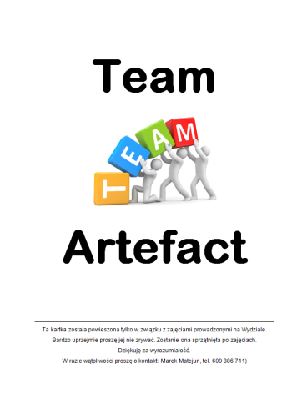
Scavenger Hunt
Task: | Points
1. Take a creative, promotional photo of your team, including your team name | 1
2. Send me an sms or WhatsApp message with your team name | 2
3. Take a creative selfie at my university room door | 2
4. Make a short, promotional movie (> 30 sec) with a stranger (person from the outside of the class), who recommend your team | 4
5. Take a photo of your team protecting the tree planted on 1 October 2019, which the Faculty of Management received as a gift from the Faculty of Economics and Sociology, University of Lodz (QR Code map on the wall board at the Faculty) | 5
6. Document your protest against the pollution affecting climate change carried out together with Greta Thunberg | 5
7. Grab a Team Artefact hung on the wall boards somewhere at the Faculty (6 artefacts) | 2 each
8. Make a creative drawing of the sunset on the advertising leaflet of the bank | 3
9. Make a poster with categorization (classification) of top factors for start-ups success according to Bill Gross | 3
Please report ALL tasks completion as photos/movies to my university e-mail: marek.matejun@uni.lodz.pl

Slide 10
Scavenger Hunt
Step 3: Assessment of tasks completion
The selection of the game winner

Slide 11
Scavenger Hunt
Step 4: Report & discussion on strategy & HRM practices in your team:
What kind of strategy did you adopt to achieve success in this game? (try to name this strategy!)
Was the strategy a strict/rigorous plan or was it developed during the implementation of tasks?
What stages of team building did you indicate during the game (Forming; Storming; Norming; Performing; Deforming)? What were the symptoms (characteristics) of these stages?
Who was a leader in your team and why?
What type of leadership was characteristic for your team (Transactional vs Transformational vs Distributed)?
What about relations (Cooperation vs Competition vs Coopetition) with other teams/parties during the game?
what about ethics?
What changes would you introduce to your strategy if you were to do these tasks again?
Your thoughts/feeling about the game? How could this game be improved?

