Slide 1
Case study
PizzaPortal
"Team leader: supervisor or partner?"

Slide 2
Description of the case study
PizzaPortal is an online portal that allows you to order a meal (not just pizza!) with delivery to any location
Recently, there have been some problems related to the coordination of activities carried out by the company's marketing departments located in Berlin and Lodz, as well as a decline in motivation and enthusiasm for work in the team you lead. All this has led to a decline in the company's performance, which needs to be dealt with
Your task is to take on the role of Marketing Director at PizzaPortal and take action to improve the company's performance.
Tasks:
Analyze the causes of the occurring problem using an Ishikawa diagram
Determine what the course of your work day should be according to the McGregor's Y theory. What mistakes did the Marketing Director make during the work day?
Send presentation to my e-mail: marek.matejun@uni.lodz.pl (including team members!)

Slide 3
Ishikawa diagram
The Ishikawa diagram, also known as a fish (or fishbone) diagram, is a method developed by Japanese professor Kaoru Ishikawa. It is used to identify possible causes of a specific problem of a complex and multi-dimensional nature. The structure of the finished diagram reminds the shape of a fish skeleton - that's where the name of the diagram comes from.
As assumed, the diagram is useful for analyzing the causes of a problem and listing its most significant areas to work on and look for improvements and enhancements.
The procedure for using this method includes 4 steps:
Step 1: in the place symbolizing the head of the fish, a specific problem is presented
Step 2: all possible categories (groups) of causes of the problem are written on the ends of the ribs of the skeleton. Among the categories, the most common are:
human/people - a group of social causes related to people
machine/equipment - group of technical causes related to machines, equipment
methods/procedures used - group of organizational causes, related to management methods and procedures
management - group of causes related to the work of managers
environment - group of external causes, originating from the environment

Slide 4
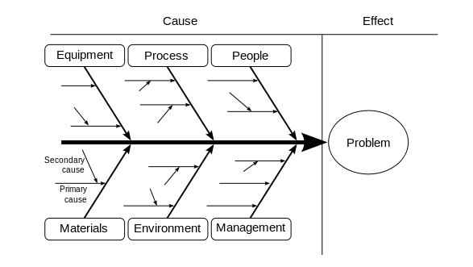
Ishikawa diagram
Step 3: at the ends of the "bones" running from the ribs, the specific causes of the problem are written down, falling into a particular category
Step 4: The diagram prepared in this way is used for further work, including the analysis of the problem and the formulation the solutions to be applied in practice

Slide 5
XY Theory of Douglas McGregor
In his theory, Douglas McGregor presented two different views on managers' approach to managing people, perceptions of human nature, approach to work, duties and taking on new challenges by employees.
According to X Theory, managers perceive their employees as averse to their duties, characterized by a negative and reluctant approach to their tasks, seeking to avoid work, new challenges and responsibilities:
a person does not like work and will avoid it if possible,
a person must be forced or bribed to make due efforts,
people prefer to be guided, they want to avoid responsibility, they mainly want security. Their ambitions are low,
a person is motivated mainly by money and takes a job mainly out of concern for material security,
in order for employees to show commitment they need to be controlled and a system of punishment has to be applied. More often than not, they perform their tasks poorly anyway.

Slide 6
XY Theory of Douglas McGregor
According to the Y theory, managers perceive their employees as having a positive attitude toward work and their tasks, willing to take on new challenges on their own and not requiring strict control by the boss:
work is necessary for human development and is a natural part of a person's life, people do not show an innate aversion to work,
a person is interested in his work and under the right conditions can enjoy it,
the employee's internal self-discipline is more effective than external rigor,
a persons are self-directed toward acceptable and clearly defined goals. They can solve the assigned tasks in a novel way,
for the employees the greatest motivator is the opportunity for self-realization and development of their skills and personality,
people like to take on challenges and accept responsibility for their actions,
people are not stupid, but in bad organizational conditions their intellectual capabilities are used only partially.
When a manager takes an X perspective then indeed employees take such an attitude towards the work they do and perform only enough to get paid.
When the manager adopts the Y perspective employees get involved in their work and exceed their own limitations, and cooperation is positively perceived by both sides.

