Slide 1
Strategic management & thinking
Strategy is the most important action plan in each enterprise.
In general, the strategy can be defined as a program of action setting out the main (strategic) objectives of the company and ways to achieve them
The most important features of the company's strategy:
Strategy applies to a longer time horizon (even several years)
Strategy should provide answers to the most important questions:
Who we are?
What are our business aims?
What should we do in the future?
Who should be our customers?
Strategy is the activity of an owner/top management who has the necessary information and knowledge to identify all aspects of a company.
Strategy enables energy and resources to be concentrated on key activities.
Strategy allows to determine the place in the implementation of objectives for each organizational unit and each employee in the enterprise
It should be „ubiquitous/ omnipresent” in the enterprise

Slide 2
Strategic management process
Analysis of the environment:
- opportunities
- threats
Definition of the objectives:
Mission
Vision
strategic objectives
Control of the implementation of the strategy
Choice of the strategy
Strategy implementation
Strategic analysis:
Analysis of the organization and the environment
Strategic options
Analysis of the organization's potential:
- strengths
- Weaknesses

Slide 3
Definition of mission, vision and strategic objectives
In the process of strategic management, the first stage is to define the mission, vision and strategic objectives of the company's activity.
Mission: An organization's reason for being.
It concentrates on the scope of the business and what distinguishes this business from similar businesses.
Mission reflects the culture and values of top management.
Vision: specific, directional and motivational guidance for the entire organization. Concentrates on the future
Strategic objectives: Ideas that execute the mission and address key issues within the organization such as market position, innovation, productivity, resources, profitability, management, and worker performance.

Slide 4
Analysis of organization and environment (strategic analysis)
This analysis can be carried out from the point of view of various criteria and using a variety of methods and tools, such as:
Resources analysis according to Hofer and Schendel
PEST analysis
Stakeholder analysis
Value chain analysis
Analysis of 5 competition forces of M. Porter
Analysis of the life cycle of a product or organization
BCG matrix
GE matrix
SWOT analysis - synthesis of previous analyses and considerations

Slide 5
Resources analysis
One of the simplest methods of examining the potential of a company used in the phase of strategic analysis is the analysis of resources proposed by Ch.W. Hofer and D. Schendel.
It involves ordering and describing the existing resources of the company from the strategic point of view from in the functional context
In the classical approach to this method, 5 types of resources are assessed:
Financial (cash flow, creditworthiness, return on capital, degree of indebtedness, liquidity). They are often treated as basic because having them makes it possible to obtain the remaining resources.
Physical (buildings, equipment, machinery)
Human (professionals, managers, employees)
Organizational (information systems, controls, management procedures)
Technology (quality standards, brand, know-how)
All these resources are analysed in reference to the functions performed in the enterprise, i.e. production, marketing, finance, management and research and development.
The so-called matrix of functions and resources is helpful in conducting this analysis.

Slide 6
PEST Analysis
It focuses on the identification and analysis of potential changes in external factors to determine their impact on the company innovativeness and possibilities of adaptability of the company to these changes. Four types of factors are analyzed here:
Political (international and national organizations, environmental protection, taxation, internal and external trade, labour law, European integration)
Economic (economic cycles, GDP trends, interest rates, inflation, unemployment)
Socio-Cultural (demography, social mobility, lifestyle changes, education level)
Technological (technological trends in the industry, speed of technology transfer, new discoveries)

Slide 7
Stakeholder analysis
Analyses the influence of the direct environment on the enterprise in terms of so-called interest groups (stakeholders).
Stakeholders are otherwise interested, i.e. groups or persons who can influence or be dependent on the decisions of the enterprise; entities to which the enterprise has specific obligations or which can support it.
This list includes internal stakeholders (shareholders, employees, management and external stakeholders (customers, suppliers, competitors, business partners, banks, media, governmental, social and political organizations).
These groups may have a positive or negative attitude towards the company innovativeness or may be neutral at the time.

Slide 8
BCG Matrix
Next meeting ☺

Slide 9
SWOT analysis
SWOT analysis is useful for formulating business strategy
S.W.O.T. is an acronym that stands for Strengths, Weaknesses, Opportunities, and Threats.
Notes:
9

Slide 10
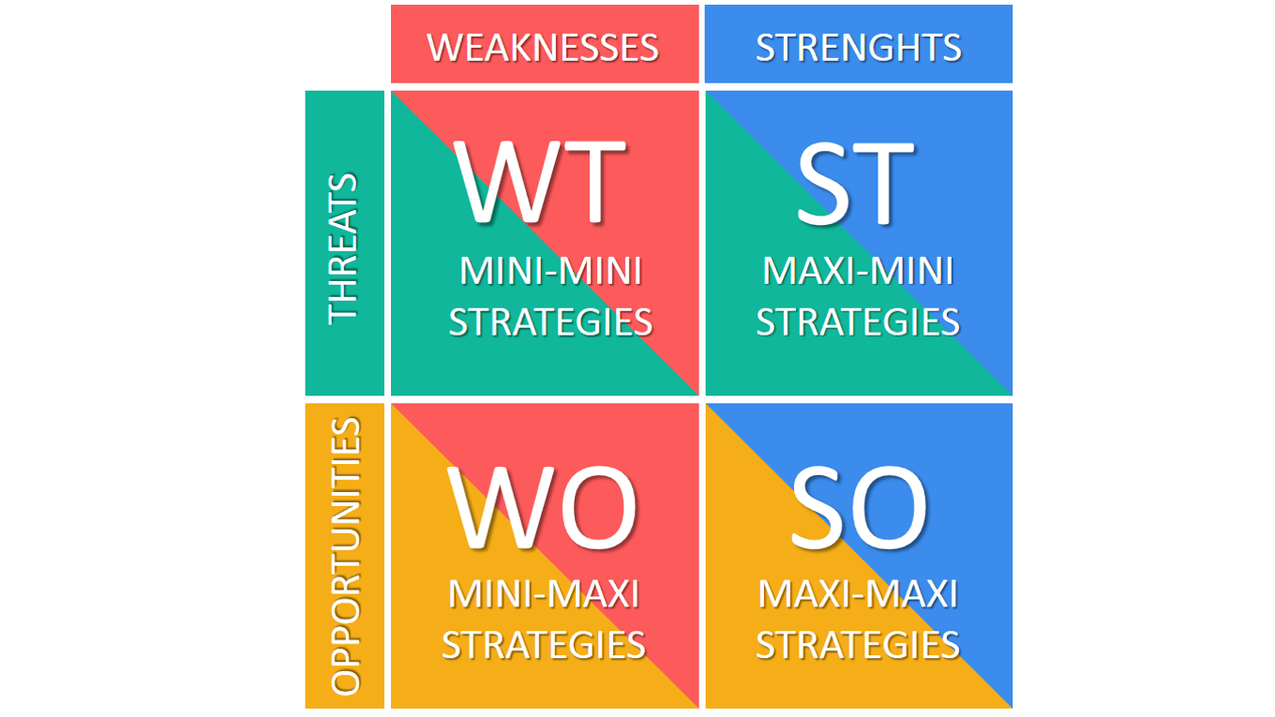
Business strategies based on SWOT analysis
survival of the organization, transformation or taking the maximum benefits before the company liquidation
selection of the products, market segmentation, product development
reducing costs, improving products, expanding resources, new markets, an entry into a strategic alliance
strong expansion, investing
Notes:
10

Slide 11
Managerial training
Divide into teams
Tasks:
Make a SWOT analysis for Adam Nowak’s Butcher factory
Based on the scope of the SWOT factors, determine the business strategy and identify sample directions for the company's development
Make short presentation and send it to marek.matejun@uni.lodz.pl (including names!)

