Slide 1
Case study of
entrepreneurial manager

Slide 2
Inspiration
Go to www.menti.com and enter the presented code.
What is entrepreneurship to you? What do you associate/link entrepreneurship with?
  Formulate your answers on your own thinking!
  Please dont use AI to answer! ☺

Slide 3

The concept of entrepreneurship
A complex, ambiguous concept, difficult to define precisely
In general terms, we usually associate „entrepreneurship” with certain characteristics or attitudes:
  innovativeness, creativity, seeking for change and responding proactively to it,
  exploration and exploitation of opportunities,
  readiness to take risks,
  acting in order to gain profit,
  running own company.
The necessity of entrepreneurship: in the family, in the local environment, in the professional life - in one's own company and in hired work, in the market economy - as a foundation for creating free market and increasing competitiveness.

Slide 4

1. Definitions that underline the economic functions
of entrepreneurship
3. Entrepreneurship
as a specific type of managerial behavior
2. Definitions that underline the personal characteristics of entrepreneurial individuals

Slide 5

Definitions that underline the economic functions
of entrepreneurship
[Hisrich, Peters]
„ Entrepreneurship is the process of creating something new with value by devoting the necessary time and effort, assuming the accompanying financial, psychic and social risks and receiving the resulting rewards of monetary, personal satisfaction
and independence”
[Vesper, Ronstadt]
initiating the taking of some action,
organizing economic mechanisms that direct resources to practical use,
accepting uncertainty and risk in one's activities.

Slide 6
Definitions that underline the personal characteristics
of entrepreneurial individuals
Commitment, engagement, determination and persistence
  overcoming barriers, obstacles, difficulties,
  compensating for disadvantages and limitations,
Strong need for achievements
  the desire to be outstanding, to succeed in a competitive environment,
  concentration on tasks and responsibilities, striving to do one's best,
Initiative and responsibility
  actively seeking and taking initiative,
  seeking out situations involving personal responsibility for results,
Seeking for feedback
  need for information about the results of one's actions,
  as a result, improvement of actions, part of the learning process.
Internal location of control
  success or failure dependent on the entrepreneur,
  limited role of luck, fate or other external forces.
Taking calculated risks
  the opposite to "risk-taking," "gambling”.„
  avoiding unnecessary risks, making well thought out decisions.

Slide 7
Definitions that underline the personal characteristics
of entrepreneurial individuals
Tolerance of uncertainty
  acceptance of constant change, stress, lack of order
  ability and willingness to act under such conditions
Honesty and trustworthiness
  attributes of a trustworthy person,
  fundamental qualities in running a business.
Ability to accept failure
  failures and defeats as an integral part of entrepreneurial behavior,
  failures more instructive than successes.
Creativity and innovativeness
  a change-seeking attitude,
  creating new ideas, using ideas in a different way,
Self-confidence and optimism
  necessary in difficult moments,
  positive thinking, focus on success.
The need for autonomy, independence
  the desire to operate outside of bureaucratic systems,
  the desire to make decisions independently.

Slide 8
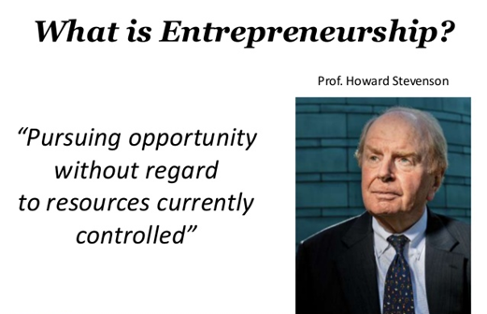
The „best” definition of entrepreneurship
Entrepreneurship
as a specific
type of
managerial
behavior
Strategic thinking and orientation
  formulating a strategy based on vision and opportunities,
  not being limited by available resources.
Engaging in opportunities
  hunting for opportunities,
  taking quick action,
  acting in a revolutionary style.
Team building abilities
  ability to select people,
  maintaining high motivation among co-workers.
Hiring specialists
  Knowledge of how to exploit the capabilities of specialists.
Direct contact with the environment
  Developing social communication
  networks and structures.

Slide 9
Training: Deepjyoti's Nath entrepreneurial story
Deepjyoti Nath: student from University of Lodz, entrepreneur, creator of Robo-UV
Divide into 3 teams.
Watch video: Robo-UV: Deepjyoti's Nath entrepreneurial story PL (visit YT – „Marek Matejun” – video)
VC = Venture capital: a form of financing new business ventures involving an investor's capital engagement to a new company
Task:
Based on the video prepare short presentation (abt. 10 minutes) which elements/facts of Deepjyoti’s Nath story fit into the definition of entrepreneurship:
  (1) that underline the economic functions of entrepreneurship (by Hisrich & Peters)
  (2) that underline the personal characteristics of entrepreneurial individuals,
  (3) as a specific type of managerial behavior (including the definition from Howard Stevenson)
  AND answer the question: Does a given theory (definition) of entrepreneurship is supported or not supported by Deepjyoti's Nath case?
Base directly on theory presented during lecture! Support your findings with specific statements or facts from the Deepjyoti's Nath story
Send presentation to: marek.matejun@uni.lodz.pl (include names of team members)
Additional task ☺ Please like this video ☺ watch, like & comment my other videos ☺

