Slide 1
Managerial Games: Case Studies in BM
Warming-up questions
What is business management?
Business – action to make money; BM is task to make a team, to build a team, to achieve best performance together; company planning, organizing, leading/motivating and controlling its resources, to achievie businesses/ team goals, all actions to make company sustainable

Slide 2
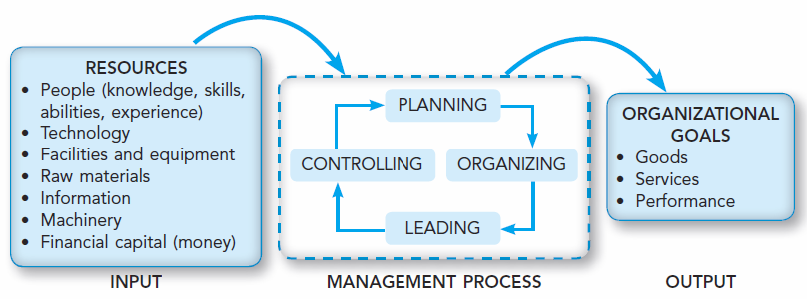
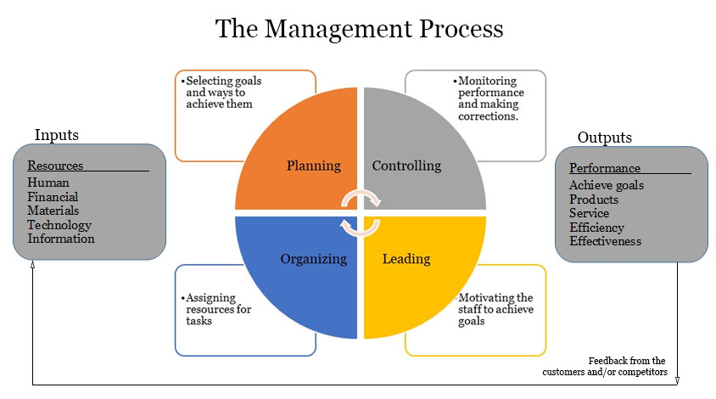
Management
Management: a complex and comprehensive set of activities/functions: (1) planning,
(2) organizing, (3) motivating/leading and (4) controlling accomplished by managers in organizations, aimed at organization’s resources in order to achieve organizational goals/performance effectively and efficiently.
Effectiveness: The degree to which
an organization achieves its goals.
It is about doing the right things,
achieving set goals. Managers are
effective when they select the right
or appropriate things to be done and
achieve them well.
Efficiency: The degree of how well resources are used to achieve a specific goal. It is about doing things right. Managers are efficient when they can minimize the amount of resources (such as people, technology, time and money) used to obtain goals.

Slide 3
Management process
Functions of management:
Planning (and decision making)
  Involves setting appropriate and clear goals and objectives, and establishing appropriate strategies to accomplish them. Clear goals provide the framework within which the organization’s strategies are formulated.
Organizing
  The process of arranging and coordinating organizational resources to carry out the organizational plan. Determines the tasks to be done, how the tasks are to be grouped, who is in charge of what, and who reports to whom.
Motivating/leading
  The process of motivating staff (subordinates) and inspiring others towards achieving organizational goals. Managers need to be leaders in order to get others to do their best in fulfilling plans and achieving goals.
Controlling
  Controlling is the final link in the chain of management functions. Managers evaluate and monitor individuals, groups, departments and whole organizations to see how well each level is on target towards achieving its goals. Effective control systems allow managers to know how well plans are being implemented. If the standard is not met, necessary corrective actions or changes need to be carried out.

Slide 4
Planning in business management
Planning – a process aimed at defining the organization's business objectives as well as the methods and resources by which these objectives will be achieved.
  Planning - the basis for all other management functions: planning, organizing, leading/motivating, and controlling
The first stage of the planning process is to define the objectives of the business activity
  Mission/vision of the company: Mission defines the company’s business, its objectives and its approach to reach those objectives. Vision describes the desired future position of the company. Mission and Vision Statements are often combined to provide a statement of the company’s purposes, goals and values.
  Strategic objectives - focus on broad, far-reaching challenges aimed at achieving the mission/vision of the company. They include e.g.:
    providing investors with 20% profit for at least 3 years, gaining 25% of the market by 2025, opening a new network of outlets within 5 years,
  Tactical objectives - these are medium-term objectives, they focus on how to achieve the strategic objectives. They include e.g.:
    to open 40 new outlets this year, develop a new promotional campaign for the product,
  Operational objectives - related to short-term problems related to tactical objectives. They include e.g.:
    hire and train a new employee, reduce waste by 5% this month.
These objectives are the basis for the development of the organization's action plans

Slide 5
Planning in business management
Planning is a process and involves making a number of specific managerial decisions:
What actions should be carried out to reach the objectives?
Who should do it?
How should they be implemented?
Where should they be implemented?
When should they start and when should they end?
By what means (resources) should they be implemented?
In what quantities should they be achieved?
What effects do we expect to achieve?
How will we measure the results achieved?
3 basic types of plans in the organization:
Strategic plan(s) (strategy) – is a general plan containing the most important decisions concerning the allocation of resources, priorities and activities aimed at achieving strategic objectives. It is most often developed by senior managers and usually has a longer time horizon (over 1 year)
Tactical plans - aimed at achieving tactical goals. They generally involve a higher and medium level of management in the medium term (up to 1 year)
Operational plans - focus on the short term, are set by middle and lower level managers, relate to the implementation of operational objectives (week-month)

Slide 6
Planning in business management
Principles of a successful planning process:
The principle of planning reality - the plan should be ambitious but achievable
The principle of consistency and logic of the plan - the plan should be internally integrated: tasks should be agreed between the teams and plan executors. An appropriate relationship between the execution time (integration of short - operational, medium – tactical and long-term – strategic plans) should be established.
The principle of generality and flexibility of the plan - the plan should be formulated relatively generally in order to was flexible, give the opportunity to use the creativity of the executors in order to be able to consider several options for implementation
The principle of detail and accuracy of the plan - however, it should be presented in detailed way so that everyone can fully understand its scope and stages of implementation.
The principle of internalization of the plan and the formulation of tasks - the planning process should take into account the opinions of the executors and formulate the tasks in such a way that they can understand them.

Slide 7
Decision making in business management
Decision making - the process of collecting and processing information in order to choose the appropriate action from among specific options.
Challenges of decision making in management:
Poor information (lack of information, unceretain information): most decisions involve many complex variables – it is necessary to analyse varius aspects of situation on the basis of various data and information. Lack of information leaves a manager a drift in a sea of uncertainty.
Too much information (information selection challenge): when the manager have too much information it can deplete his/her ability to make best decision.
Lack of time to make a decision: managers often work and make decisions under strong time pressure
Incorrect timing: it is also the challenge of selecting an appropriate time for taking the decision. If the decision is correct but the time is inopportune, it will not serve any purpose.
Lack of empowerment to make decisions: connected with the hierarchy of decision making. Sometimes you have a great idea, but no formal power to make a decision.
Un-supporting environment: if there is all round goodwill and trust in the organization/team the manager is encouraged to take decisions. On the other hand he/she avoids decision-making. Sometimes the people from the company even make it difficult to make decisions by proposing, for example, inappropriate solutions.
Ineffective communication of a decision: the manager should take care to communicate all decisions to the employees in clear, precise and simple language.
Lack of control over the implementation of the decision: managers sometimes forget to control the implementation of the decision.

Slide 8
Decision making in business management
The model of rational decision-making
This model allows to identify, evaluate and select a specific course of action (decision) leading to the solution of a specific problem or to the use of an emerging opportunity. It is based on 4 steps:
Analysis of the problem
  identification of the problem to be solved
  the definition of the objectives of the decision
Search for potential solutions
  searching for potential solutions without evaluating them
Evaluation of potential solutions and selection the best solution
  evaluation of the value of the proposed solutions in terms of: their feasibility, impact on the solution of the problem, consequences for the company
  The decisions taken should take into account the synergy effect - the way in which different areas of activity complement and support each other.
  choosing the best solution
Implementation of the decision and monitoring of the effects
  preparation of the implementation (selection of persons, allocation of resources, development of plans, schedules)
  implementation of the decision
  monitoring of implementation and possible adjustments of actions.

Slide 9
Decision making in business management
The synergy effect in decision making
It occurs when cooperation and interaction of separate components (people, departments, enterprises) leads to greater overall efficiency than if each of these components acted separately.
It is written illustratively in the form of an equation: 2 + 2 = 5
It means a situation in which the contribution of particular components of an activity (e.g. enterprises cooperating in the implementation of a project) gives a greater effect than if each of these enterprises implemented the project on its own.
It does not appear on its own and requires various managerial actions, supplemented with knowledge and skills, appropriate management of time, coordination of resources, etc.

Slide 10
Case study
MakoLab - planning and decision making in business management

Slide 11
Planning and decisions making in BM
Work in teams (multinational if possible!)
Each team will receive a case study description (content of the exercise)
Please read the content of the exercise in details and then answer 2 questions
Type of the case study: closed
Time limit
After the time: discussion on results

Slide 12
Planning and decisions making in BM
MakoLab implements a new IT project including the development of an innovation „semantic ontology for the automotive industry”.
The company's resources are limited, so the company must choose one strategic partner in cooperation with whom it will implement the project.
Your task is to take on the role of the manager of this project and to implement its first phase, related to the selection of a strategic partner.
Tasks:
  On the basis of the model of rational decision making (first 3 steps), make a decision regarding the selection of a strategic partner in cooperation with whom MakoLab will implement the project:
    Identification of the problem to be solved:
    Decision options - potential partners:
    Partner selected to cooperate in project implementation:
  Indicate the synergy effect resulting from the cooperation with the selected partner.

