Slide 1
Management is performed by managers
A manager is a person responsible for planning and directing the work of a group of individuals, monitoring their work, and taking corrective action when necessary.
A manager is someone who coordinates and directs the work of other people so that organizational goals can be accomplished
A manager is the organizational memeber authorized to tell others what to do and how to do it.
Manager differs from nonmanagerial employees that he is responsible for the work, which does not perform himself, but also by his/her subordinates.
There are various managers in modern organizations. They can be classified according to level and area of management

Slide 2
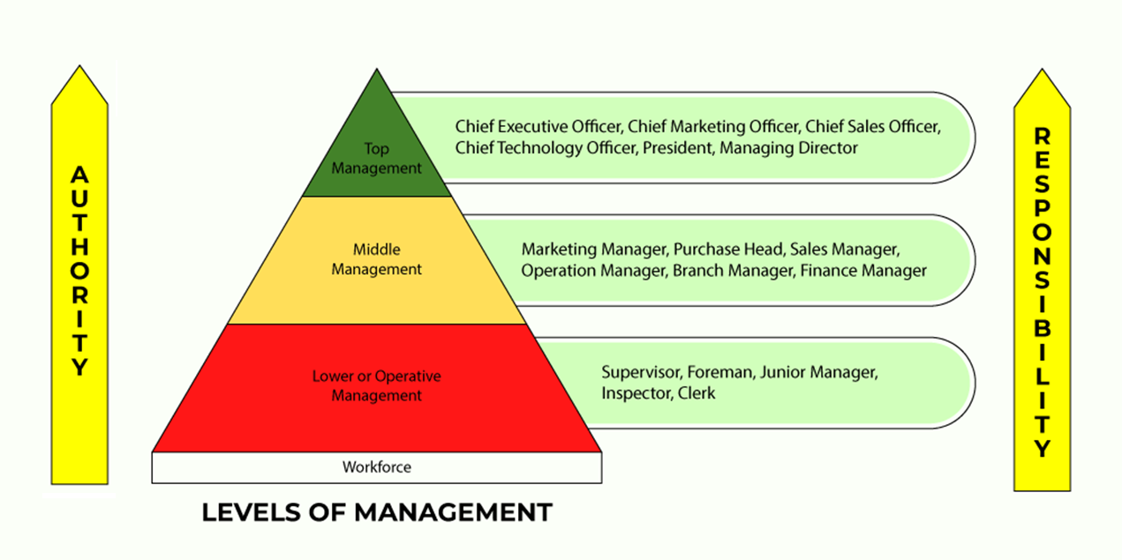
Managers according to level of management
https://www.geeksforgeeks.org/levels-of-management/
Administrative or Top Level of Management.
Executive or Middle Level of Management.
Supervisory or Lower Level of Management.

Slide 3
Managers according to level of management
The main functions of the top level management:
The top level management determines the objectives, policies and plans of the organization.
They mobilizes (assemble and bring together) available resources.
The top level management does mostly the work of thinking, planning and deciding. Therefore, they are also called as the Administrators and the Brain of the organization.
They spend more time in planning and organizing. They prepare long-term plans of the organization which are generally made for 5 to 20 years. The top level management has maximum authority and responsibility.
They are directly responsible to the shareholders, law/government and the general public.
The success or failure of the organization largely depends on their efficiency and decision making.

Slide 4
Managers according to level of management
The main functions of the middle level management:
Middle level management executes (implements) the policies and plans which are made by the top level management.
The middle level management has limited authority and responsibility.
They are intermediary between top and lower management. They are directly responsible to the Chief Executive Officer and Board of Directors.
They spend more time in co-ordinating and communicating.
It co-ordinate the activities of all the departments. They also have to communicate with the top level management and the lower level management.
They prepare short-term plans of their departments which are generally made for 1 to 5 years.
Middle level management also gives recommendations (advice) to the top level management.

Slide 5
Managers according to level of management
The main functions of the lower level management:
Lower level management directs and leads the employees. They develops morale and angagement of the workers.
It maintains a link between workers and the middle level management. The lower level management informs the workers about the decisions which are taken by the management.
They also inform the higher management about the performance, difficulties, feelings, demands, etc., of the workers.
They spend more time in directing, leading and controlling.
The lower level managers make daily, weekly and monthly plans.
They have limited authority but important responsibility of getting the work done by the workers.
They regularly report and are directly responsible to the middle level management.

Slide 6
Managers according to area of management
General managers - supervise the entire unit and are not associated with any specific area. They coordinate the activities of all the managers of specialized areas. They should have a basic knowledge of all areas of management.
Functional managers - have responsibility for only one type of activity, e.g.:
Marketing managers. Responsible fora acquiring customers and consumers for the organization's products and services; development of new products; promotion, distribution of products and services
Finance managers. Responsible for accounting; cash management; analysis of financial liquidity; investments; determining the profitability of business
Production managers. Responsible for production control, inventory management; quality control, design of production technologies
Human resources managers. Responsible for HR planning, recruitment and selection of employees; HR training and development; design of incentive systems; formulation of employee performance appraisal systems;
Public-relations managers. Responsible for public and media relations
Research and development managers. Coordinate the activities of scientists and engineers working on research and development projects for new products and services

Slide 7
Managerial roles
The concept of 10 Managerial Roles, According to Henry Mintzberg
10 managerial roles divided into 3 categories:
3 Interpersonal roles: This category covers behaviors, tasks and responsibilities related to interactions with employees and other stakeholders. Through these interactions, the manager can achieve organizational goals. The managerial roles included in this category are (1) figurehead, (2) leader and (3) liaison.
3 Informational roles: This category represents situations when a manager generates, receives or shares information and/or knowledge inside and/or outside of the organization. The managerial roles included in this category are (4) monitor, (5) disseminator and (6) spokesperson.
4 Decisional roles: This category describes a manager's responsibility to use the information they gain to form strategic and operational decisions. The managerial roles included in this category are (7) entrepreneur, (8) disturbance-handler, (9) resource-allocator and (10) negotiator.

Slide 8
Managerial roles
Interpersonal roles
(1) Figurehead: this role refers to your responsibility as a manager to perform tasks related to social, symbolic or legal matters. In these situations, you are not making decisions but serving as a representative of the organization. As a figurehead, you also aim to inspire your team to complete goals and tasks.
(2) Leader: refers to your duty as a manager to oversee the performance of your staff. Overall, you aim to manage the team and the responsibilities of each member to ensure you reach objectives effectively. Some of your duties in this role include providing guidance, developing and motivating staff and performing evaluations.
(3) Liaison (connector): in this role you create and maintain internal and external relationships. You serve as a connection between different groups or people to ensure work runs smoothly. As a liaison, you can transfer knowledge or information to members across your organization's chain of command or communicate between stakeholders and employees to ensure projects remain on task. In some situations, you may bring members of your external network into the company to help achieve organizational goals more efficiently.

Slide 9
Managerial roles
Informational roles
(4) Monitor: in this role you seek information related to your organization, such as potentially impactful industry changes. Your research includes both internal and external sources. Once you gather all the relevant information, you will analyze it to identify and solve potential problems. Monitoring responsibilities also include assessing the current operations of the organization and identifying potential opportunities for improvement.
(5) Disseminator: as a disseminator, you receive messages from internal and external sources that you convey to the appropriate individuals or groups inside the organization. You can transmit this information in both verbal and written formats. Usually, this situation refers to valuable or otherwise important information that will benefit your organization or provides guidance on tasks your employees need to complete.
(6) Spokesperson: in this role you represent your organization and convey information, such as goals or policies, to external stakeholders. If you work within a large organization, you may need to serve as the spokesperson of your team and represent it during external meetings or events.

Slide 10
Managerial roles
Decisional roles
(7) Entrepreneur: this role involves responsibilities related to organizing and running business processes. These responsibilities include solving problems and developing and implementing new ideas or strategies. As an entrepreneur, your ideas or decisions often promote innovative solutions that move the organization forward.
(8) Disturbance handler: when your organization or team faces unexpected challenges, you take the role of a disturbance handler to help manage the issue. These challenges can be both external or internal – whether a client backs out of a contract or you discover a conflict between colleagues. In these situations, your employees will expect you to take charge to solve the issue and maintain productivity.
(9) Resource allocator: in this role you are responsible for managing and distributing resources across the organization. You make the decisions on how those materials will best be used or applied throughout the organization or team. These resources will vary, from funding to equipment to staff members.
(10) Negotiator: in this role you participate in negotiation situations. These negotiations may occur with external parties, where you will represent the interests of your organization. You may also host negotiations with internal parties, such as other departments or your team members.

Slide 11
Managerial game: Roles of managers
Work in teams
Each team randomly picks 1-2-3 roles according to the concept of H. Mintzberg (don't show/tell what role it is!!).
Then prepare in the team a scene presenting the role - you can play the role of the manager, employees, outsiders of the organization - depending on the needs of the managerial role
After the preparation, each group plays the scene in the middle of the room, and the other participants try to guess/find which managerial role it is about ☺
  at the beginning introduce what characters play in the scene!
  especially indicate a manager whose role we will try to find!

Slide 12
(1) Figurehead: this role refers to your responsibility as a manager to perform tasks related to social, symbolic or legal matters. In these situations, you are not making decisions but serving as a representative of the organization. As a figurehead, you also aim to inspire your team to complete goals and tasks.
(2) Leader: refers to your duty as a manager to oversee the performance of your staff. Overall, you aim to manage the team and the responsibilities of each member to ensure you reach objectives effectively. Some of your duties in this role include providing guidance, developing and motivating staff and performing evaluations.
(3) Liaison (connector): in this role you create and maintain internal and external relationships. You serve as a connection between different groups or people to ensure work runs smoothly. As a liaison, you can transfer knowledge or information to members across your organization's chain of command or communicate between stakeholders and employees to ensure projects remain on task. In some situations, you may bring members of your external network into the company to help achieve organizational goals more efficiently.
(4) Monitor: in this role you seek information related to your organization, such as potentially impactful industry changes. Your research includes both internal and external sources. Once you gather all the relevant information, you will analyze it to identify and solve potential problems. Monitoring responsibilities also include assessing the current operations of the organization and identifying potential opportunities for improvement.
(5) Disseminator: as a disseminator, you receive messages from internal and external sources that you convey to the appropriate individuals or groups inside the organization. You can transmit this information in both verbal and written formats. Usually, this situation refers to valuable or otherwise important information that will benefit your organization or provides guidance on tasks your employees need to complete.
(6) Spokesperson: in this role you represent your organization and convey information, such as goals or policies, to external stakeholders. If you work within a large organization, you may need to serve as the spokesperson of your team and represent it during external meetings or events.
7) Entrepreneur: this role involves responsibilities related to organizing and running business processes. These responsibilities include solving problems and developing and implementing new ideas or strategies. As an entrepreneur, your ideas or decisions often promote innovative solutions that move the organization forward.
(8) Disturbance handler: when your organization or team faces unexpected challenges, you take the role of a disturbance handler to help manage the issue. These challenges can be both external or internal – whether a client backs out of a contract or you discover a conflict between colleagues. In these situations, your employees will expect you to take charge to solve the issue and maintain productivity.
(9) Resource allocator: in this role you are responsible for managing and distributing resources across the organization. You make the decisions on how those materials will best be used or applied throughout the organization or team. These resources will vary, from funding to equipment to staff members.
(10) Negotiator: you participate in negotiation situations. These negotiations may occur with external parties, where you will represent the interests of your organization. You may also host negotiations with internal parties, such as other departments or your team members.

