Slide 1
Strategic management & thinking
Strategy is the most important action plan in each enterprise.
In general, the strategy can be defined as a program of action setting out the main (strategic) objectives of the company and ways to achieve them
The most important features of the company's strategy:
Strategy applies to a longer time horizon (even several years)
Strategy should provide answers to the most important questions:
  Who we are?
  What are our business aims?
  What should we do in the future?
  Who should be our customers?
Strategy is the activity of an owner/top management who has the necessary information and knowledge to identify all aspects of a company.
Strategy enables energy and resources to be concentrated on key activities.
Strategy allows to determine the place in the implementation of objectives for each organizational unit and each employee in the enterprise
It should be „ubiquitous/ omnipresent” in the enterprise

Slide 2
Strategic management process
Analysis of the environment:
- opportunities
- threats
Definition of the objectives:
Mission
Vision
strategic objectives
Control of the implementation of the strategy
Choice of the strategy
Strategy implementation
Strategic analysis:
Analysis of the organization
and the environment
Strategic options
Analysis of the organization's potential:
- strengths
- Weaknesses

Slide 3
Definition of mission, vision
and strategic objectives
In the process of strategic management, the first stage is to define the mission, vision and strategic objectives of the company's activity.
Mission: An organization's reason for being.
  It concentrates on the scope of the business and what distinguishes this business from similar businesses.
  Mission reflects the culture and values of top management.
Vision: specific, directional and motivational guidance for the entire organization. Concentrates on the future
Strategic objectives: Ideas that execute the mission and address key issues within the organization such as market position, innovation, productivity, resources, profitability, management, and worker performance.

Slide 4
Analysis of organization and environment
(strategic analysis)
This analysis can be carried out from the point of view of various criteria and using a variety of methods and tools, such as:
Resources analysis according to Hofer and Schendel
PEST analysis
Stakeholder analysis
Value chain analysis
Analysis of 5 competition forces of M. Porter
Analysis of the life cycle of a product or organization
BCG matrix
GE matrix
SWOT analysis - synthesis of previous analyses and considerations

Slide 5
Resources analysis
One of the simplest methods of examining the potential of a company used in the phase of strategic analysis is the analysis of resources proposed by Ch.W. Hofer and D. Schendel.
It involves ordering and describing the existing resources of the company from the strategic point of view from in the functional context
In the classical approach to this method, 5 types of resources are assessed:
  Financial (cash flow, creditworthiness, return on capital, degree of indebtedness, liquidity). They are often treated as basic because having them makes it possible to obtain the remaining resources.
  Physical (buildings, equipment, machinery)
  Human (professionals, managers, employees)
  Organizational (information systems, controls, management procedures)
  Technology (quality standards, brand, know-how)
All these resources are analysed in reference to the functions performed in the enterprise, i.e. production, marketing, finance, management and research and development.
The so-called matrix of functions and resources is helpful in conducting this analysis.

Slide 6
PEST Analysis
It focuses on the identification and analysis of potential changes in external factors to determine their impact on the company innovativeness and possibilities of adaptability of the company to these changes. Four types of factors are analyzed here:
Political (international and national organizations, environmental protection, taxation, internal and external trade, labour law, European integration)
Economic (economic cycles, GDP trends, interest rates, inflation, unemployment)
Socio-Cultural (demography, social mobility, lifestyle changes, education level)
Technological (technological trends in the industry, speed of technology transfer, new discoveries)

Slide 7
Stakeholder analysis
Analyses the influence of the direct environment on the enterprise in terms of so-called interest groups (stakeholders).
Stakeholders are otherwise interested, i.e. groups or persons who can influence or be dependent on the decisions of the enterprise; entities to which the enterprise has specific obligations or which can support it.
This list includes internal stakeholders (shareholders, employees, management and external stakeholders (customers, suppliers, competitors, business partners, banks, media, governmental, social and political organizations).
These groups may have a positive or negative attitude towards the company innovativeness or may be neutral at the time.

Slide 8
BCG Matrix
The BCG Matrix (Boston Consulting Group Matrix) is used to analyze a company's portfolio of products and/or services.
The BCG Matrix is constructed on the basis of two variables:
  Market Growth Rate [%] in which the company operates. The average annual sales growth of the whole market/industry is most often used to determine it. It can be determined as a percentage increase of the market value in the following year in comparison with the previous year:
[market value in the following year / market value in the previous year - 1] %
  Relative Market Share [%], which can be determined by the ratio of the sales of the products of a given company to the total sales of the analyzed products in the market in which the company operates. It can be determined as:
[value of sales of the company’s product in a given year / value of the market] %
To perform the analysis, it is necessary to determine the average level of market growth and market share - to separate the "low" and "high" levels. This average level is often set individually depending on the specifics of the company and the market (industry).

Slide 9
BCG Matrix
This method is based on the assumption that the growth rate of a given market and the share of a specific product in that market determine the ability of product lines to generate profits for the company.
On the basis of the analysis of the above variables, a matrix is created, distinguishing four categories of products...

Slide 10
BCG Matrix

Slide 11
BCG Matrix
In the BCG matrix, the optimal product portfolio should include:
  a sufficient number of stars that will turn into established cash cows in the future,
  a sufficient number of cash cows, financing the development of other products;
  a certain number of question marks, which can turn into stars in the future thanks to large financial investments,
  no dogs that do not generate cash flow/profit.
The trick is to invest the financial surplus from cash cows and successful dogs in selected question marks to turn them into stars by increasing their market share. When the pace of the market slows down the stars will turn into cash cows, generating surplus cash that can be invested in promising next-generation question marks.
-
+/-
Cash flow
investments
Desired movement
+/-
+/-
+
Out of the market

Slide 12
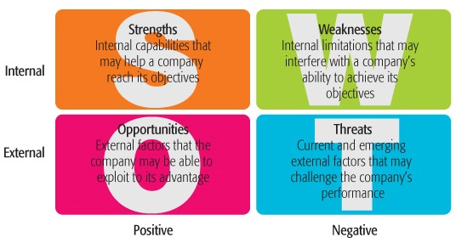
SWOT analysis
SWOT analysis is useful for formulating business strategy
S.W.O.T. is an acronym that stands for Strengths, Weaknesses, Opportunities, and Threats.
Notes:
12

Slide 13
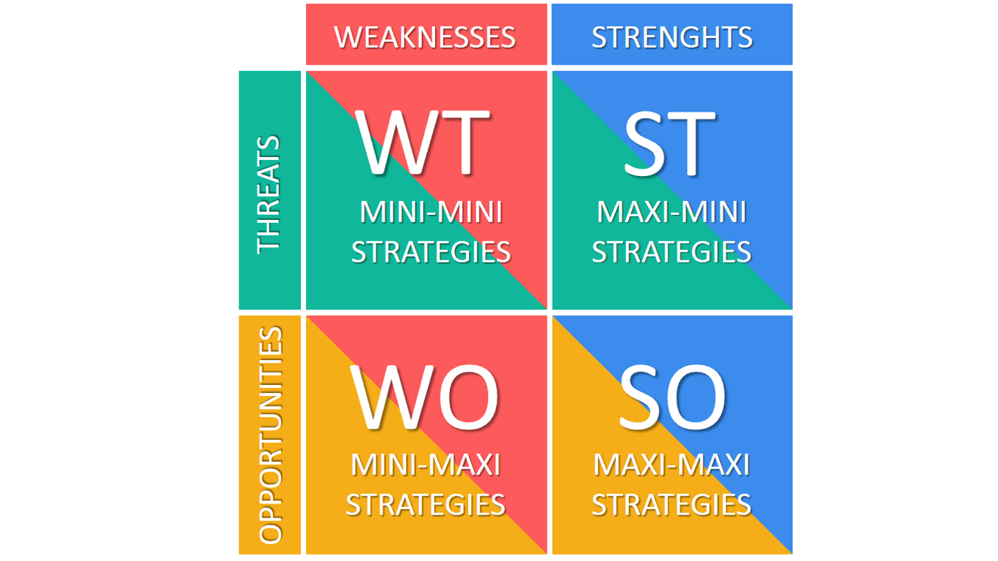
Business strategies based
on SWOT analysis
survival of the organization, transformation or taking the maximum benefits before the company liquidation
selection of the products, market segmentation, product development
reducing costs, improving products, expanding resources, new markets, an entry into a strategic alliance
strong expansion, investing
Notes:
13

Slide 14
Mangerial training: BCG Matrix
MakoLab S.A. is an IT company which offers 3 types of products:
  Fractus system - an ERP class system used for management of the sale process
  ColDis system - supporting real estate management
  e-Schola system - system for managing the course of studies in Polish higher education institutions
However, the company is currently implementing an IT project aimed at launch an innovative product - semantic ontology for the automotive industry
The management's challenge is to optimize the company's product portfolio and define the place of ontology in this structure
Tasks:
Take on the role of manager of this project and, on the basis of the values presented, prepare a BCG Matrix of the products offered by the company in the next year. The answer should indicate exactly where each product will be located in the BCG matrix (specify coordinates with specific values) – indicate them in pptx file (download at www.matejun.pl)
Answer questions: Will the product structure be optimal? What types of products will be missing or too many in the company’s portfolio?
Send pptx file to: marek.matejun@uni.lodz.pl

